Slide 1


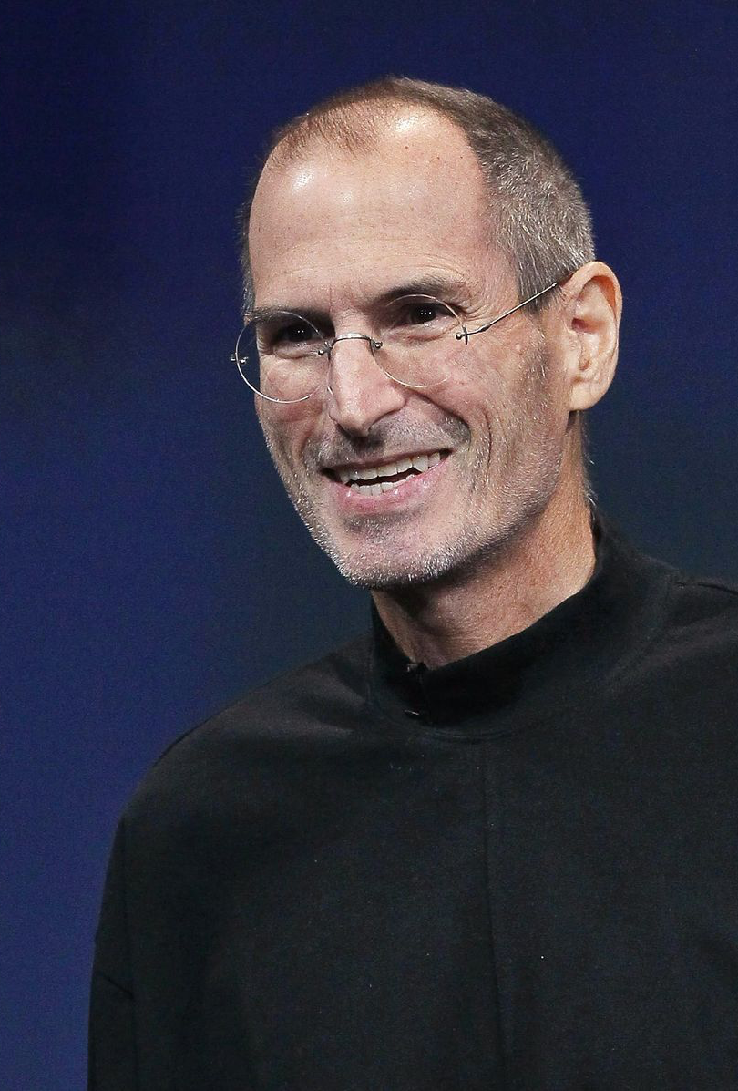

Steve Jobs
Made By Kókai Balázs and Nyers Donát

Slide 2
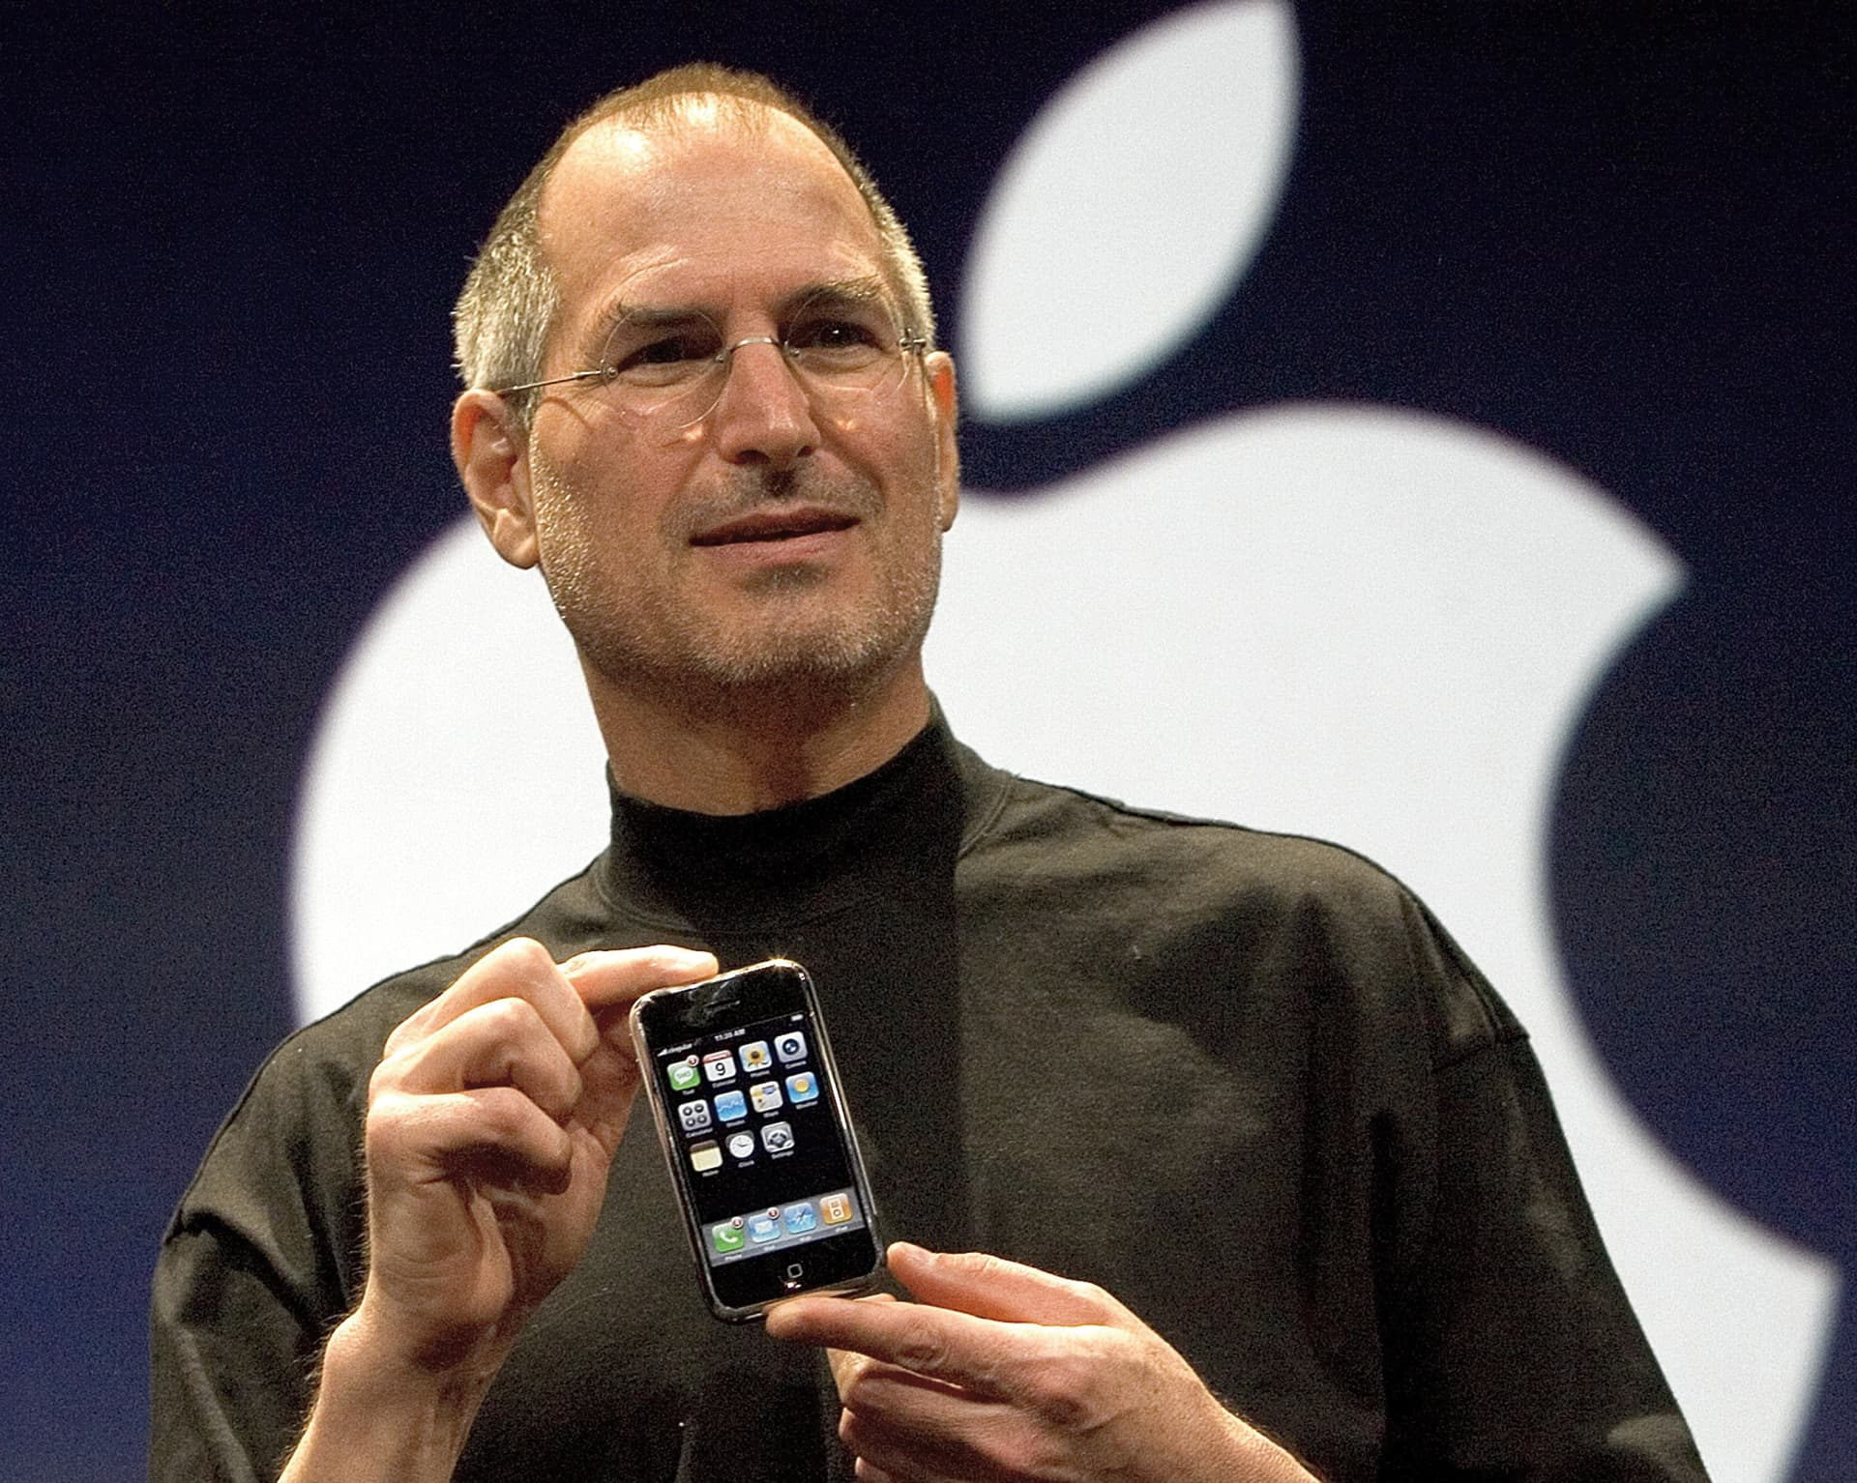
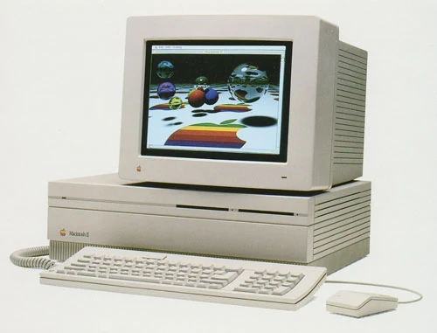
Steve Jobs was born in San Francisco in 1955
On april 1 1976 he founded Apple Computer Co. With his friend Steve Wozniak. They made the first Macintosh computer. Apple is the first company who made smartphones and had colorful displays on their computers.

Slide 3


He was banned for a time from apple and in that time he founded the company: Pixar
This company makes movies, and they made The Toy Story the first popular movie by Pixar
And he also founded an other company: NeXT, specialized in computer workstations for higher educations and business markets (Famous successful applications: the first web browser and the video games Doom and Quake)

Slide 4
Return to Apple (1997)
Job’s big successes with Apple
iPod portable music player with iTunes Music Store (mp3 based)
On June 29, 2007, Apple entered the cellular phone business with the introduction of the iPhone
2008, Steve Jobs introduce the new Macbook Air (computer in an envelope show on WWDC) – The Word’s Thinnest Notebook

Slide 5
Steve Job’s Death
In October 2003 Steve Jobs was diagnosed whit cancer. he announced to his employees that he had a cancerous tumor in his pancreas
Steve Jobs resisted his doctors' recommendations for medical intervention for nine months
On January 17, 2011, a year and a half after Jobs returned to work following the liver transplant
Jobs died at his home in Palo Alto, California, on October 5, 2011

Slide 6
Little interesting things:
also what i mentioned earlyer, in 1985 Apples board belived for he wasnt ready for the CEO role of Apple, so they banned him and at that ime he founded that other two company
Also he had a little autism
He also didn’t tough for he need to shower because he only ate fruit His B.O. was owful.

Slide 7
Sources
Google
Wikipedia

Slide 8
Thanks For Watching!

